Slide 1
Notes on: Mixed dimensional isogeometric FE-BE coupling analysis for solid–shell structures
Two different ways of mapping of DOFs of solid and shell
Condition of interface equilibrium for constructing ‘monolithic’ stiffness matrix

Slide 2
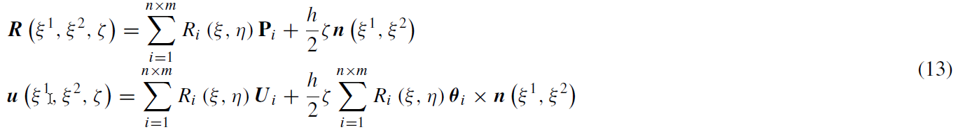
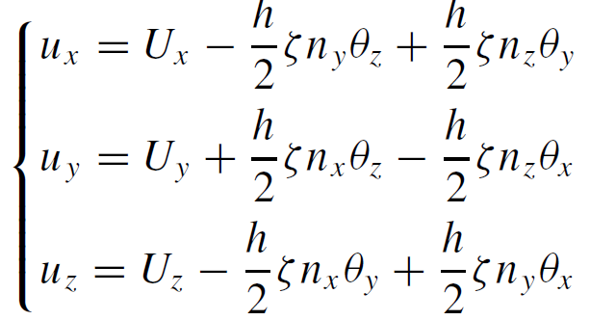
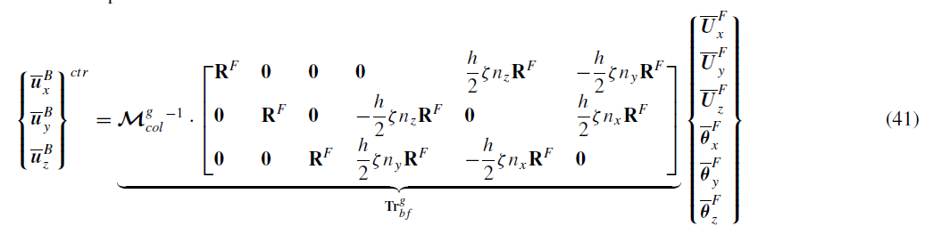
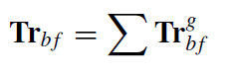
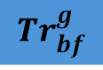
Direct kinematic coupling
Geometry description for R-M shell
$${Tr}_{bf}^{g}$$
Displacement field for Solids (translation only)
(in global coordinates system)
Translation and rotation fields for shell (in global coordinates system)

Slide 3
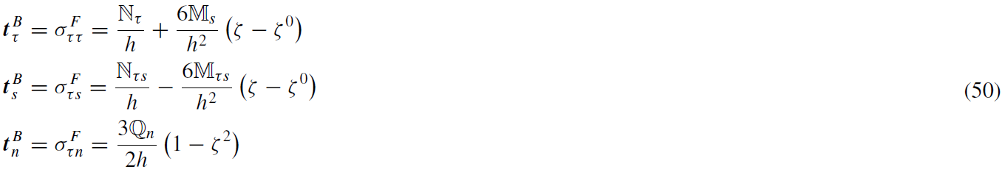
Weak coupling formulation based on work equality
Force equilibrium condition on the coupling interface

Slide 4
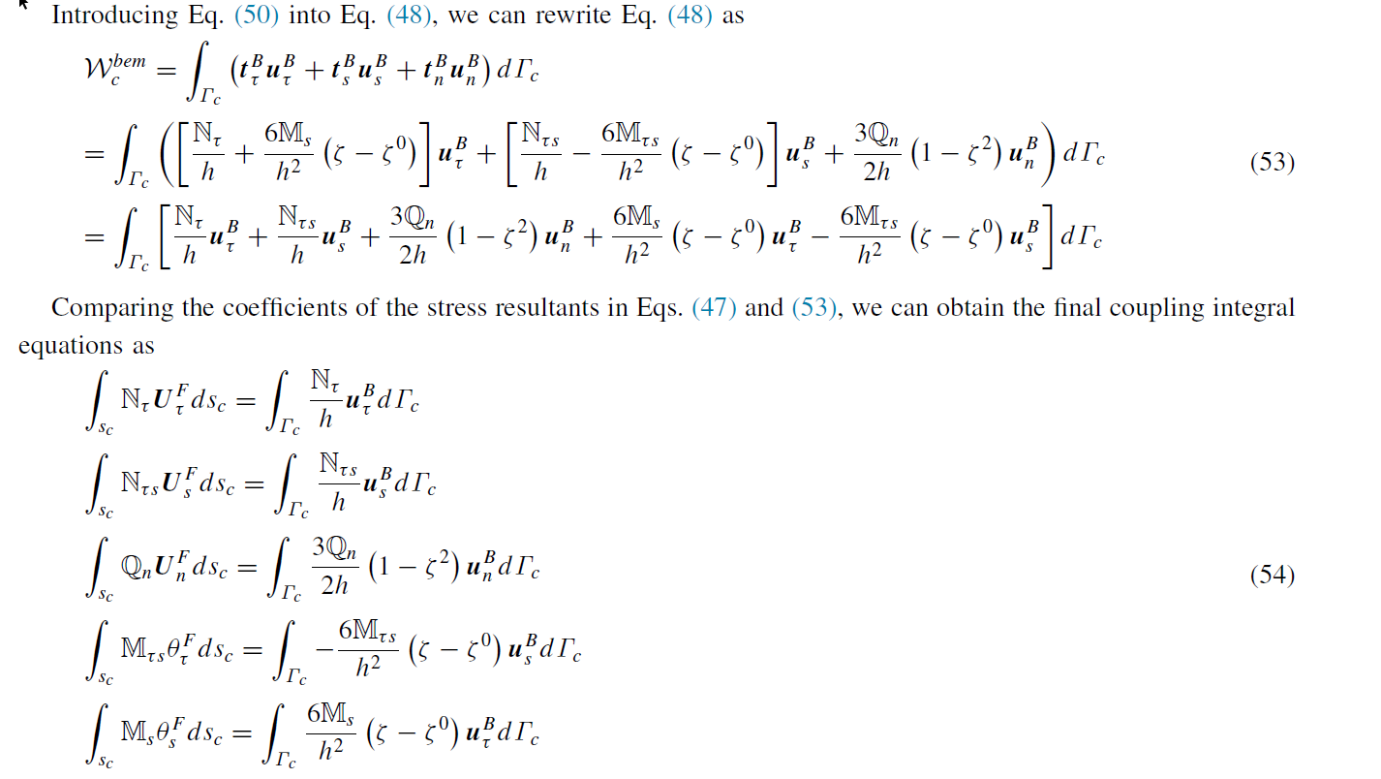
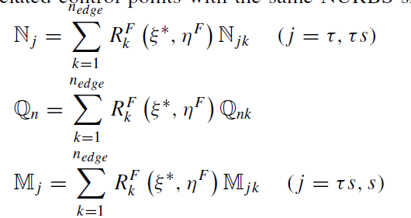
Weak coupling formulation based on work equality
Discretizing stress resultants
Transform for local coos to global coos

Slide 5
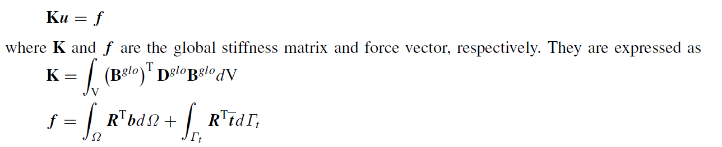
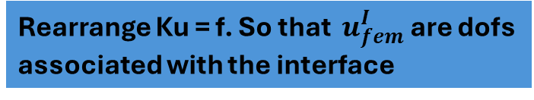
Governing equations of the coupled system Part 1: Shell - FEM
Rearrange Ku = f. So that $u_{fem}^{I}$are dofs associated with the interface
Integral of body forces and tractions on all surfaces except interface surface
Only traction in the interface

Slide 6
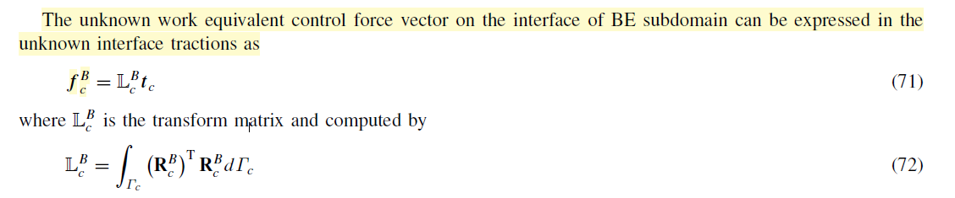
Governing equations of the coupled system Part 2: Solid - BEM
For BEM, there are no body forces. In paragraph 3.2, it is explained how to rearrange the displacements of BEM. Finally

Slide 7
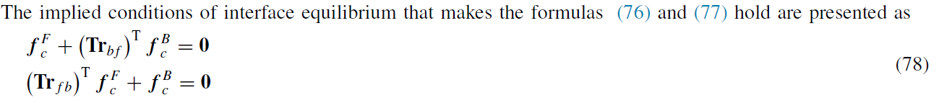
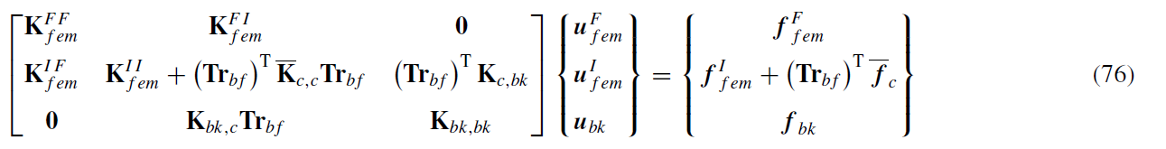
Governing equations of the coupled system Final coupling
Direct kinematic coupling
Weak coupling formulation
Finally:

Slide 8
Notes on: Numerical procedure to couple shell to solid elements by using Nitsche’s method
Notes regards only Shell element MITC4 (method for MITC4ts is the same)
Continuity condition is reached using penalty method
Nitsche method is used to impose the constraint condition

Slide 9
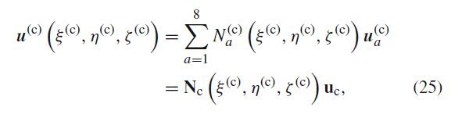
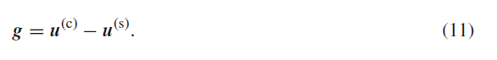
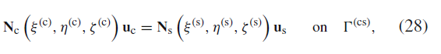
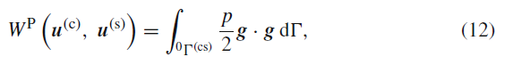
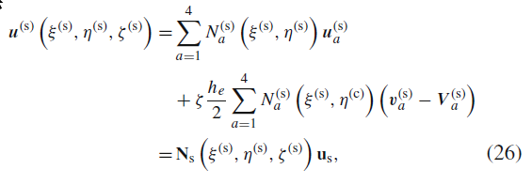
Continuity condition on connecting surface
Penalty factor

Slide 10
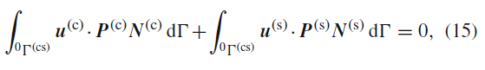
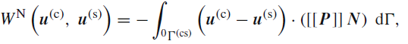
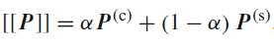
Traction work on interface is zero
α Nitche parameter

Slide 11
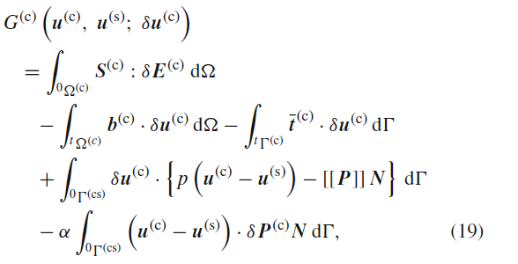
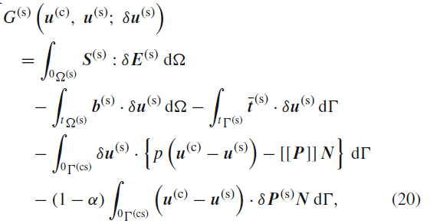
Variation of potential energy for δυc, δυs

Slide 12
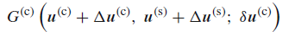
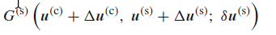
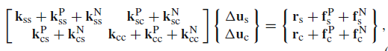
Incremental form of variational equations

Slide 13
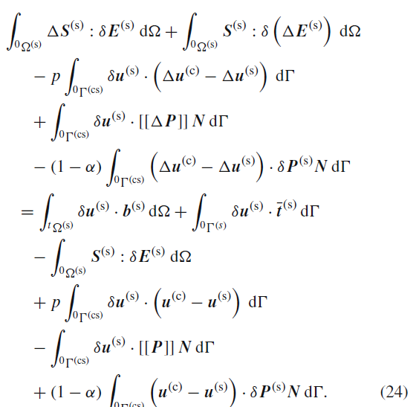
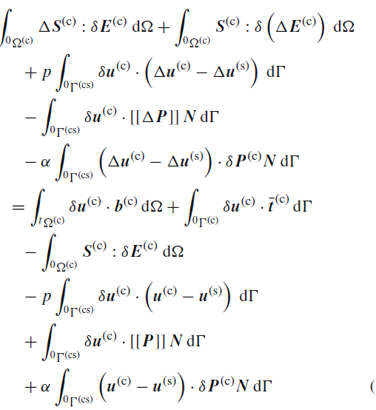

Slide 14
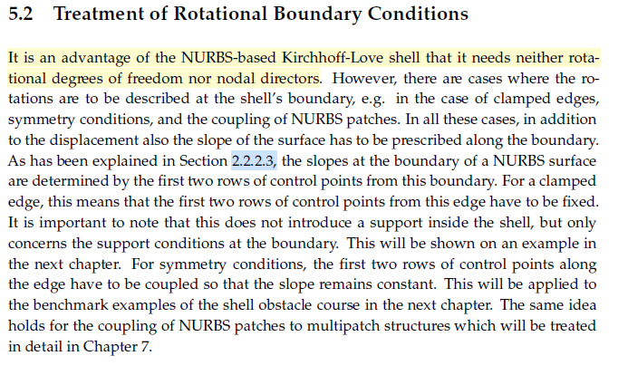
Goals
Do we want to couple thick or thin elements?
Isogeometric Analysis and Shape Optimal Design of Shell Structures Josef M. Kiendl

Slide 15
Goals
Do we want monolithic or partitioned coupling?
For monolithic we can implement the same as 1st paper
For partition we can use Mortat based mapping for 1. displacements and 2. force equilibrium (integrals of tractions of solid and shell)
The difference is that solid will use B-spline basis functions (QuEso) and shell NURBS
For simplification we can say that the surface of the interface of solid (or edge) is not trimmed

Slide 16
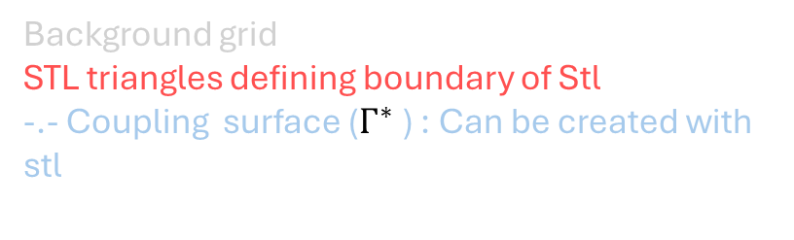
Solid
Background grid
STL triangles defining boundary of Stl
-.- Coupling surface ($Γ^{∗}$) : Can be created with stl

Slide 17
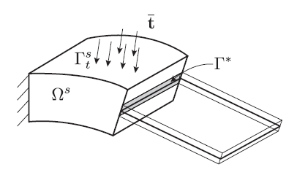
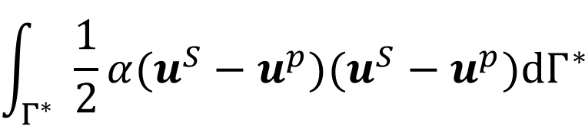
Penalty (deformation penalty for coupling)
$$\int_{Γ^{∗}}{\frac{1}{2}α(u^{S}−u^{p})(u^{S}−u^{p})dΓ^{∗} }$$

Slide 18
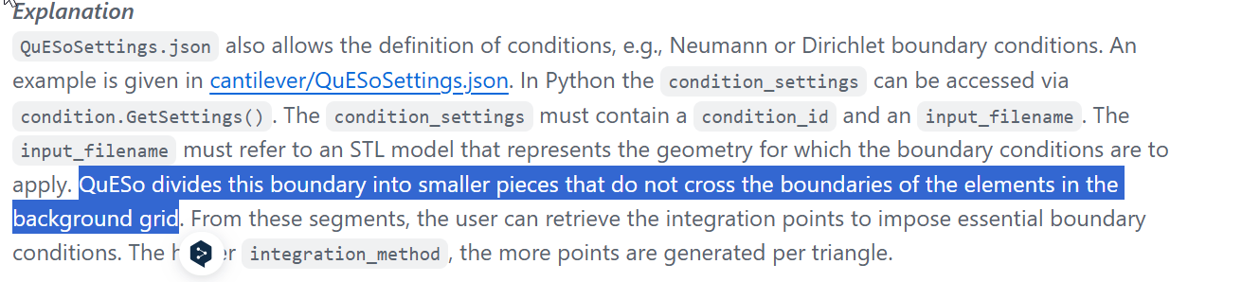
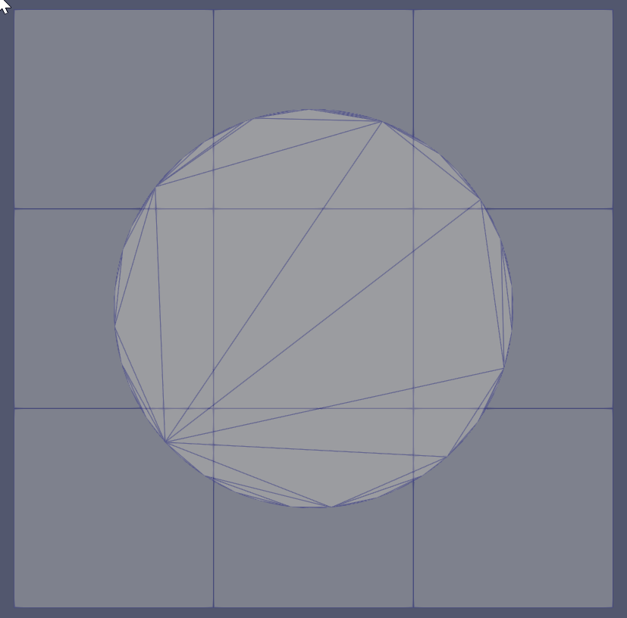
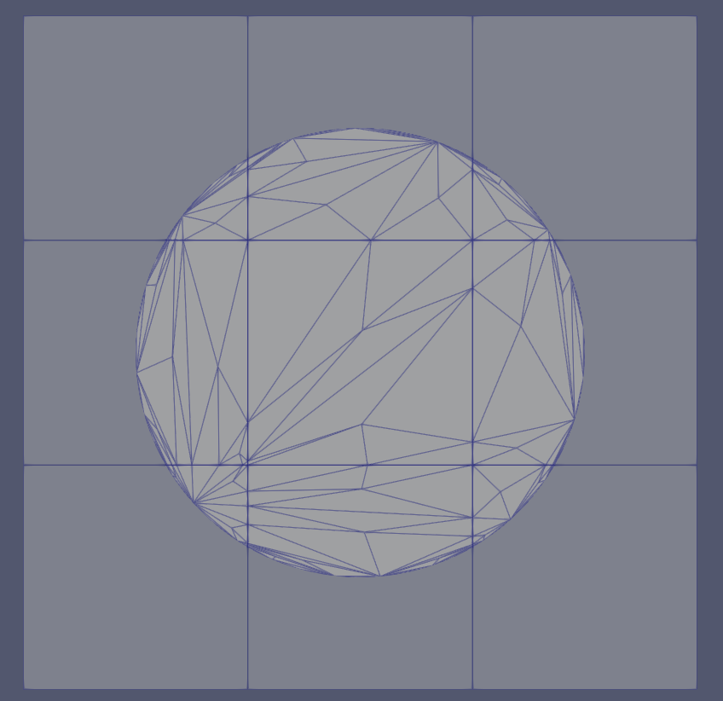

Slide 20
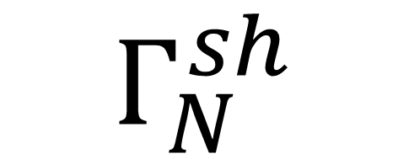
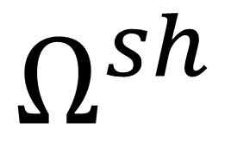
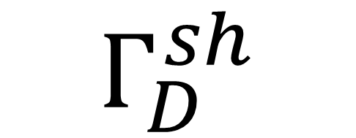
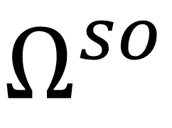
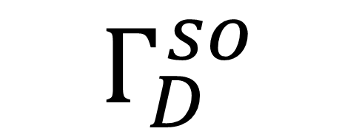
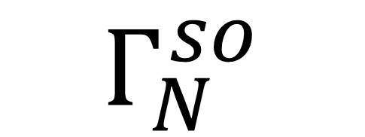
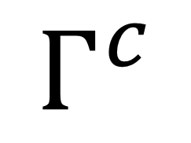
$$Γ^{c}$$
$$Γ_{N}^{so}$$
$$Γ_{N}^{sh}$$
$$Ω^{so}$$
$$Ω^{sh}$$
$$Γ_{D}^{so}$$
$$Γ_{D}^{sh}$$

Slide 21
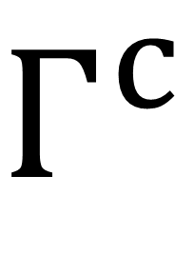
Shell
Solid
$$Γ^{c}$$

Slide 22
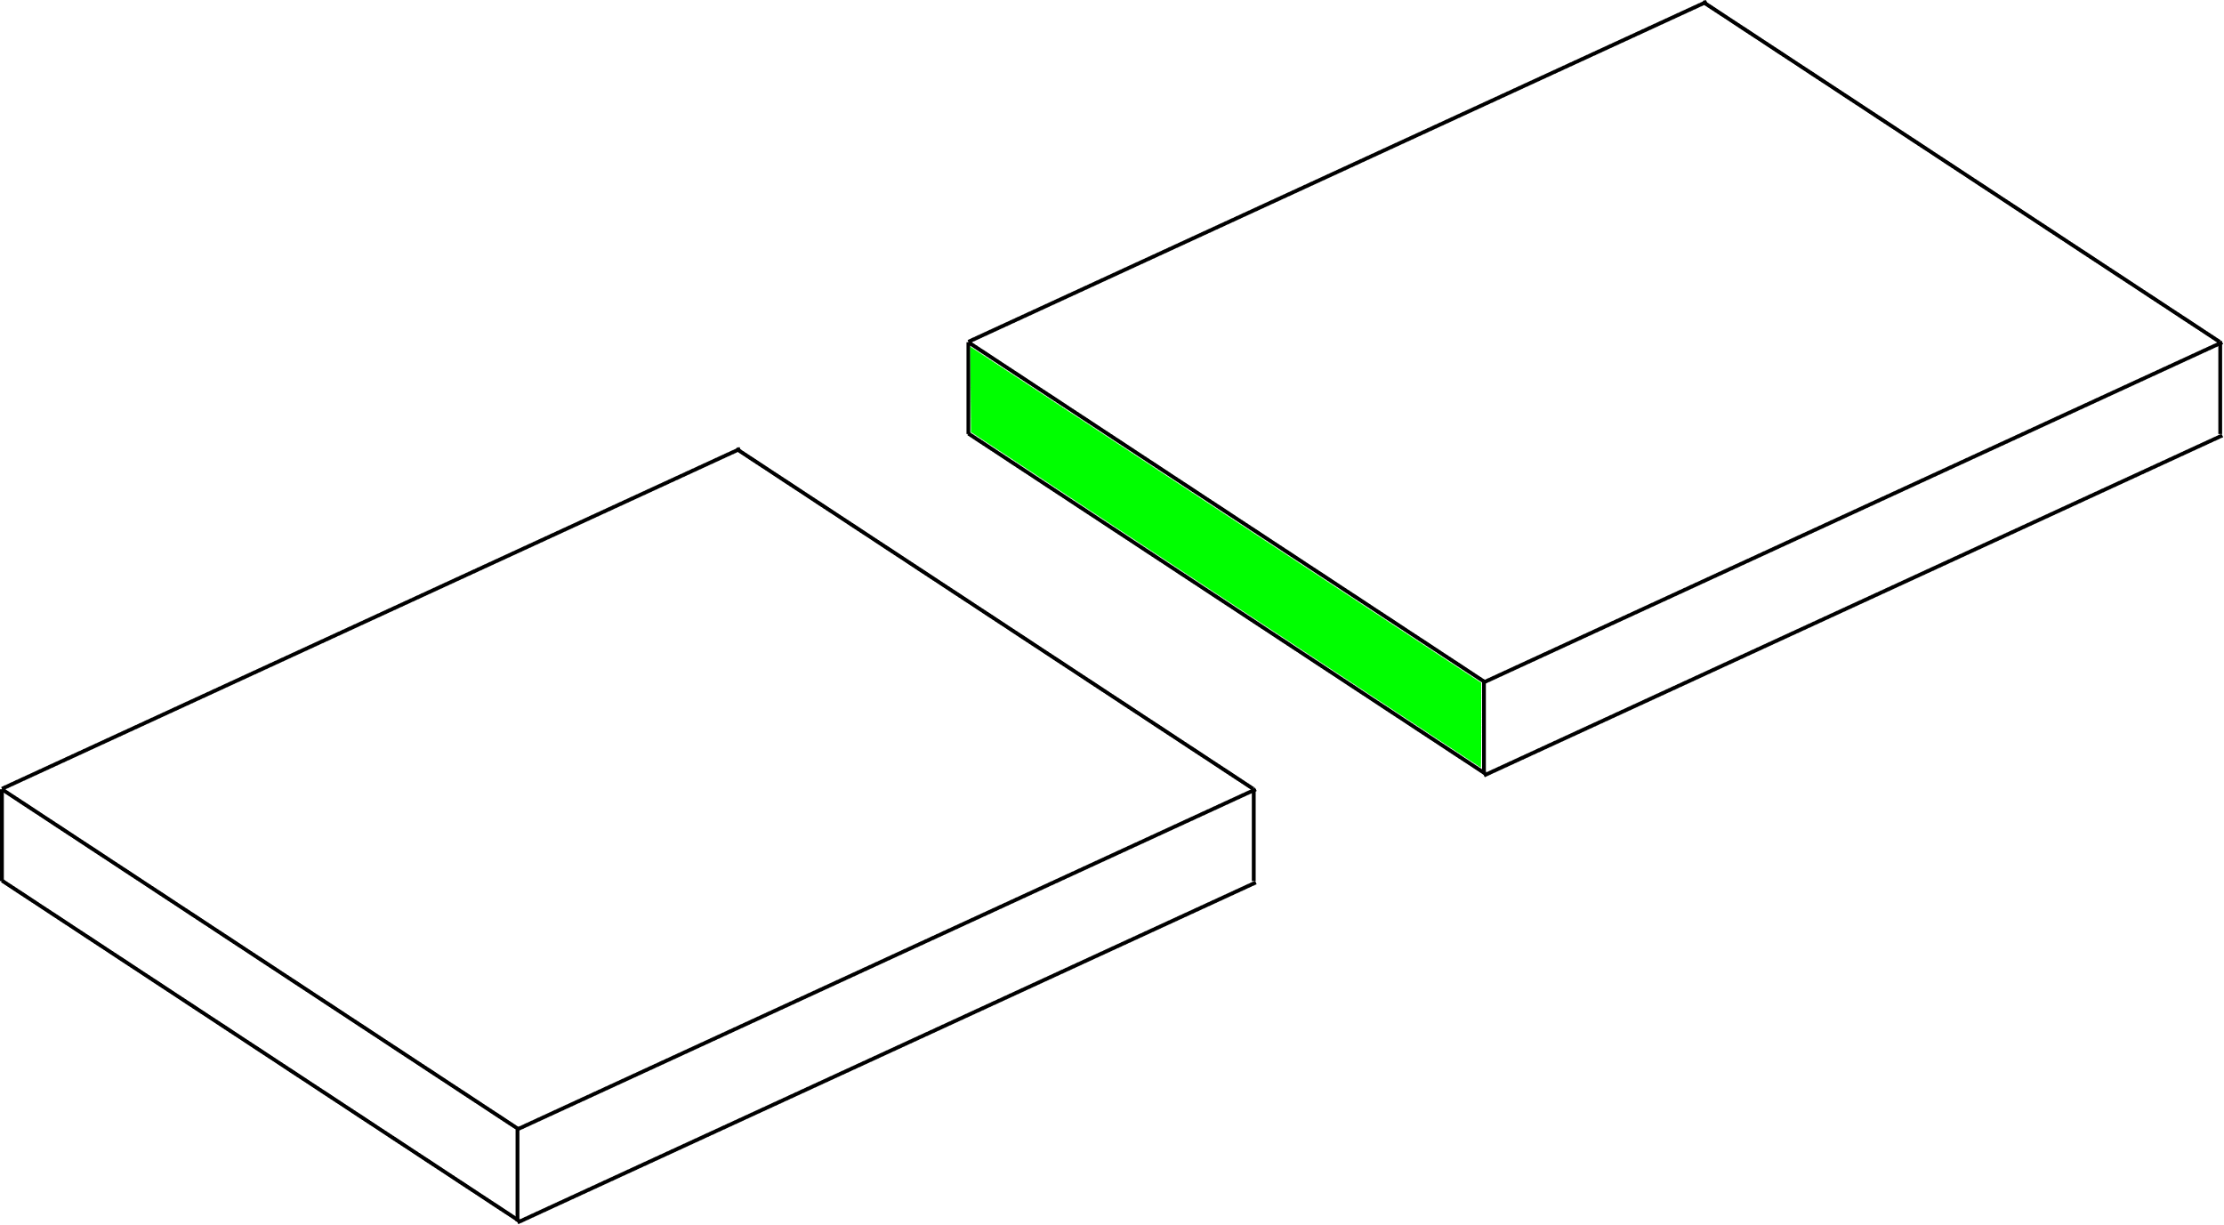
Shell
Solid
$$Γ^{c}$$

Slide 24
Goal:
Quadrature point Geometries (Boundary of Solid)
Quadrature point Geometries (Boundary of Shell)
Coupling Geometries

Slide 25
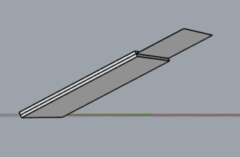
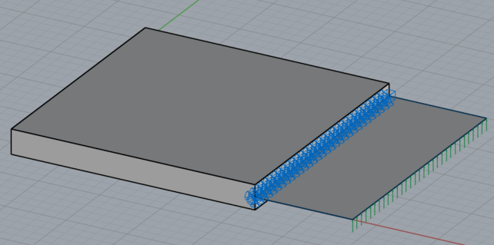
Created two examples
Cuboid with faces parallel to cartesian axis Example 02
Cuboid with faces not parallel to cartesian axis
Example 03

Slide 26
Before implementation
Queso model part Neumann BCs (coupling interface)
Queso model part Dirichlet BCs
Cocodrilo: LoadCondition
Cocodrilo: Support, Support Rotational (coupling interface)
For both cases the brep_ids of the shell curve in the coupling interface is [6]

Slide 27
Before implementation
Get Geometry of IgaModelPart which lies on the coupling interface (curve)
Create PointerVector<Geometry<Node>> to store master(solid) and slave(shell) geometries and IntegrationPointsArrayType to store the local coordinates for every integration point of coupling interface of the solid
Loop on Neumann Conditions of Solid (where integration points are):
Pass Geometry of condition to PointerVector of the master (the geometries are quadrature point geometries)
Project integration point of the solid to Geometry of IgaModelPart and obtain local coordinates and store it to IntegrationPointsArrayType
Create Quadrature Point Geometries using the Geometry of IgaModelPart
Loop and create Coupled_Quadrature_Point_Geometries
Combine Solid and Shell (this step in not done in the beginning because combination reorders the IDs of the geometries of shells and solids to avoid having the same id. In step 1 we need to take the geometry by knowing the ID of the geometry which lies on the interface)

Slide 28
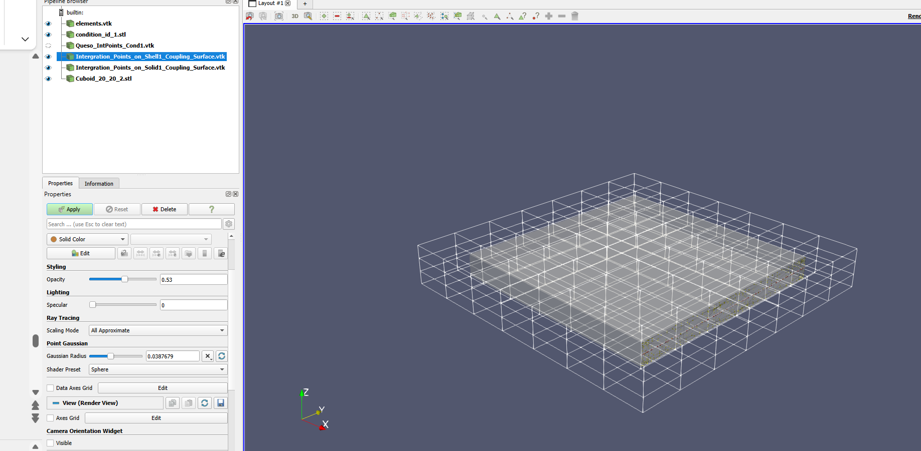
Example 02

Slide 29
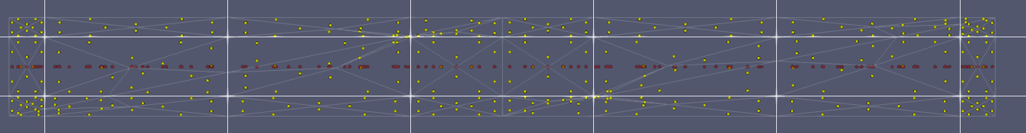
Example 02

Slide 30
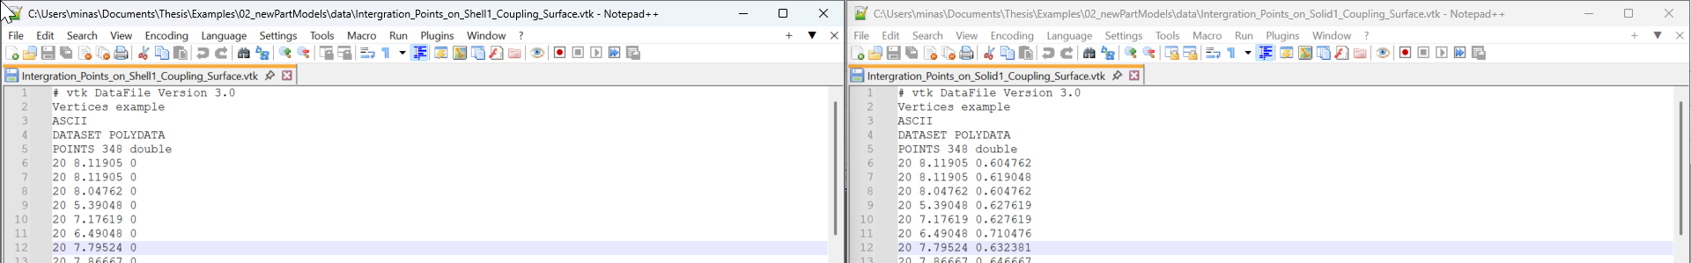
Example 02

Slide 31
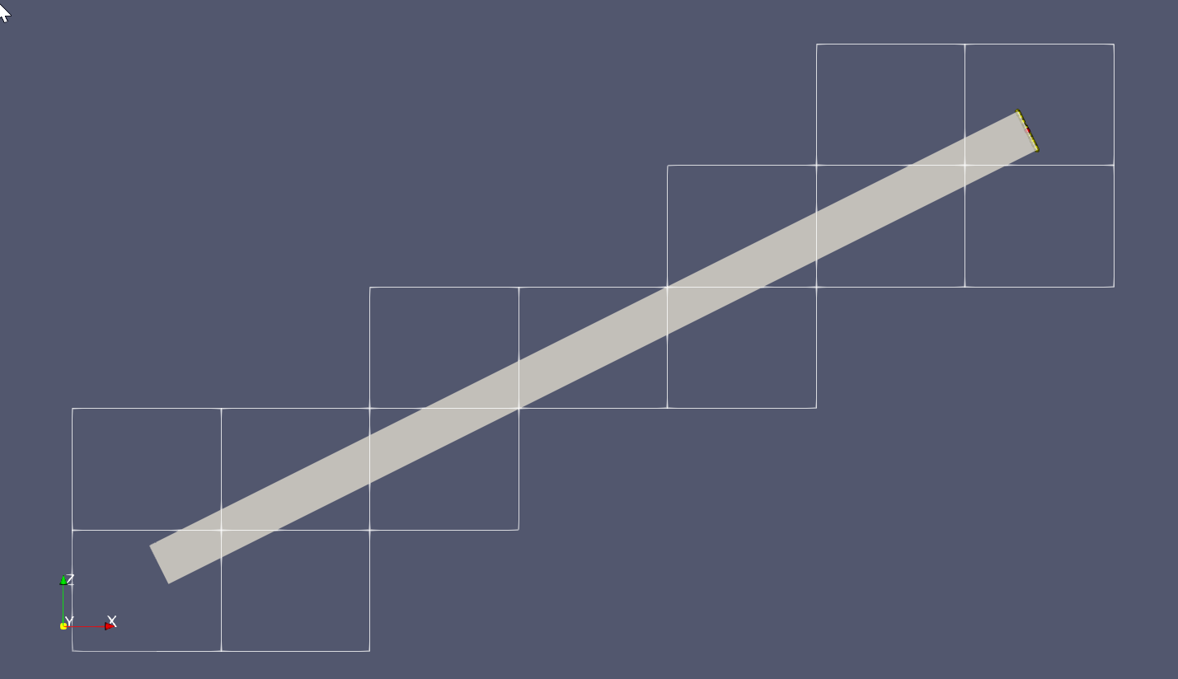
Example 03
Queso Neumann BCs
Queso Dirichlet BCs

Slide 32

Example 03

Slide 33

Example 03

Slide 34

Questions:
1. NumberOfShapeFunctionDerivatives : is that the order of the derivaties that we want to store?
2. IntegrationInfo is not used because we have already the integration points
3. On Coupled_Quadrature_Point_Geometries the master(solid) geometry is QuadraturePointGeometry and for the slave(shell) QuadraturePointCurveOnSurfaceGeometry. Shouldn’t the master(solid) geometry be QuadraturePointSurfaceInVolumeGeometry ?
4. For QuESo: Integration points for Dirichlet_BCs are 1 per triangle while for Neumann BCs are for 3 per triangle. Why is that?

Slide 35

Questions:
Note: For queso integration points for Dirichlet BCs are 1/triangle and for Neumann 3/triangle, no matter the polynomial order of polynomial degree of the shape functions associated with the “finite elements” used in the 3D background grid.
My understanding is that for each triangle we have a discretization with 3 nodes and linear shape function associated to them. They are the boundary representation of the volume and they don’t depend from the polynomial degree of the shape functions of the background grid. There is just a mapping of the nodes and their shape functions of each triangle with the CPs and parametric space of the background grid. The deformations on the b-rep of the solid will be of continuity C1 ?
Similarity with shells?
trimming curve Γ1
trimming curve is a curve of degree p=1 (linear shape funciton). We want to apply Dirichlet BCs with penalty on Γ1 . If there is no refinement of the trimming curve the integration points of $\int_{Γ1}{α u_{B−rep}^{Γ1} u_{B−rep}^{Γ1} dΓ^{1}}$ will be the same. We don’t care about any refinement of the surface
surface

Slide 36
Next steps
Create coupling condition including the coupling geometries
Start inserting parameters on the process to be easier (for example choosing the b_rep id from the shell, choosing which models to combine, which model to delete by name)

Slide 37







Integration points for Neumann BCs (QueSo)
$$\int_{Γ^{Ν}}{\overline{t}} ∙δu dΓ^{Ν}= \int_{0}^{1}{\int_{0}^{1−\tilde{η}}{δu(ξ(\tilde{η},\tilde{ξ}))∙ \overline{t}\left(\tilde{η},\tilde{ξ}\right)} \left|J_{x→\tilde{η}}\right| d\tilde{ξ} d\tilde{η}= }{δ\hat{u}}^{Τ}\int_{0}^{1}{\int_{0}^{1−\tilde{η}}{Ν^{Τ}(ξ\left(\tilde{η},\tilde{ξ}\right))∙}\left[\begin{aligned}t_{x}\left(\tilde{η},\tilde{ξ}\right) \\ t_{y}\left(\tilde{η},\tilde{ξ}\right) \\ t_{z}\left(\tilde{η},\tilde{ξ}\right)\end{aligned}\right]\left|J_{x→\tilde{η} }\right|d\tilde{ξ} d\tilde{η}}$$
Integration rule for triangles: $\int_{0}^{1}{\int_{0}^{1−s}{g(s,r)} dr ds }= \sum_{i=1}^{GPs}{w_{i}}g\left(s_{i},r_{i}\right)$
t is constant $\left[\begin{aligned}t_{x}\left(\tilde{η},\tilde{ξ}\right) \\ t_{y}\left(\tilde{η},\tilde{ξ}\right) \\ t_{z}\left(\tilde{η},\tilde{ξ}\right)\end{aligned}\right]=\left[\begin{aligned}t_{x} \\ t_{y} \\ t_{z}\end{aligned}\right]$
$$N1\left(\tilde{η},\tilde{ξ}\right)=1 −\tilde{η} −\tilde{ξ}$$
3
$$N2\left(\tilde{η},\tilde{ξ}\right)=\tilde{η}$$
$$\int_{0}^{1}{\int_{0}^{1−\tilde{η}}{Ν^{Τ}(ξ\left(\tilde{η},\tilde{ξ}\right))∙}\left[\begin{aligned}t_{x} \\ t_{y} \\ t_{z}\end{aligned}\right]\left|J_{x→\tilde{η}}\right|d\tilde{ξ} d\tilde{η}}$$
$$\tilde{ξ}$$
$$N3\left(\tilde{η},\tilde{ξ}\right)=\tilde{ξ}$$
1
$$\tilde{η}$$
2

Slide 38






$$η_{F}$$
$$X_{GP}^{so}$$
1
x
1
$$y$$
$z$
$$\det\left(J_{F^{h}}\right)$$

Slide 39



$$X_{GP}^{so}$$
x
$${θ_{GP}^{3} Α}_{3}$$
x
$$R$$

Slide 40




Gauss point on triangle solid parametric space
$$ξ_{GP}^{so}=ξ_{GP}^{so}({X_{GP}^{so}(η}_{GP}) )$$
Gauss point on triangle parametric space
Gauss point on triangle
physical space of solid
$$η_{GP}$$
$$X_{GP}^{so}={X_{GP}^{so}(η}_{GP})$$
Projection
Gauss point on shell parametric space
$$θ_{GP}^{sh}=θ_{GP}^{sh}({X_{GP}^{so}(η}_{GP}) )$$

Slide 41

Quadrature points for triangles
https://mathsfromnothing.au/triangle-quadrature-rules/
In Queso we take 3 integration points. They are more than 1 so we are on the safe side

Slide 42


Integration points on the boundaries for Solid

Slide 43


Integration points on the boundaries for Solid
C:\QuESo\queso\containers\triangle_mesh_interface.hpp
$$x_{IP(i)}=N1(η_{i},ξ_{i}) x_{1}+N2(η_{i},ξ_{i}) x_{2}+N3(η_{i},ξ_{i}) x_{3}$$
$$y_{IP(i)}=N1(η_{i},ξ_{i})y_{1}+N2(η_{i},ξ_{i})y_{2}+N3(η_{i},ξ_{i})y_{3}$$
$$z_{IP(i)}=N1(η_{i},ξ_{i})z_{1}+N2(η_{i},ξ_{i})z_{2}+N3(η_{i},ξ_{i})z_{3}$$
$$w_{IP(i)}=w_{i} \left|J_{x→η }\right|$$
For triangular elements Jacobian = const = area of triangle

Slide 44






Integration points on the boundaries for Solid
C:\QuESo\queso\containers\triangle_mesh_interface.hpp
$$N1\left(\tilde{η},\tilde{ξ}\right)=1 −\tilde{η} −\tilde{ξ}$$
3
$$N2\left(\tilde{η},\tilde{ξ}\right)=\tilde{η}$$
$$\tilde{ξ}$$
$$N3\left(\tilde{η},\tilde{ξ}\right)=\tilde{ξ}$$
1
$$\tilde{η}$$
2

Slide 45




Coupling interface area instead of line
Express displacement field of shell body as a function of mid-surface displacement field
$$u^{3p}=x −X=r+θ^{3}a_{3} −R −θ^{3}Α_{3}=v+θ^{3}\left(a_{3} −Α_{3}\right)=v+θ^{3}\left( Φ ×Α_{3}\right)⇒ \\ u^{3p}=v−θ^{3}\left(Α_{3}×Φ\right)$$
$v$: Displacement field of mid-surface
$$Φ=φ_{1}Α_{1}+φ_{2}Α_{2}$$
$$v,_{α}= \left[\begin{matrix}\begin{matrix}\frac{∂Ν^{1}}{∂θ^{α}} & 0 & 0 \\ 0 & \frac{∂Ν^{1}}{∂θ^{α}} & 0 \\ 0 & 0 & \frac{∂Ν^{1}}{∂θ^{α}}\end{matrix} & ⋯ & \begin{matrix}\frac{∂Ν^{m}}{∂θ^{α}} & 0 & 0 \\ 0 & \frac{∂Ν^{m}}{∂θ^{α}} & 0 \\ 0 & 0 & \frac{∂Ν^{m}}{∂θ^{α}}\end{matrix}\end{matrix}\right]\left[\begin{matrix}\begin{matrix}\hat{u_{1}} \\ \hat{v_{1}} \\ \hat{w_{1}}\end{matrix} \\ ⋮ \\ \begin{matrix}\hat{u_{m}} \\ \hat{v_{m}} \\ \hat{w_{m}}\end{matrix}\end{matrix}\right]$$
$$φ_{1}=\frac{1}{\left\|Α_{1}×Α_{2}\right\|}v,_{2}∙A_{3}$$
$$φ_{2}=−\frac{1}{\left\|Α_{1}×Α_{2}\right\|}v,_{1}∙A_{3}$$
See Chapter 2.1 from https://www.sciencedirect.com/science/article/pii/S0045782512003337

Slide 46



Slide 47


Coupling interface area instead of line
$$cross matrix operator:{\left[A_{3}\right]}_{×}= \left[\begin{matrix}0 & −A_{3z} & A_{3y} \\ A_{3z} & 0 & −A_{3x} \\ −A_{3y} & A_{3x} & 0\end{matrix}\right]$$
$$v,_{α}= \left[\begin{matrix}\begin{matrix}\frac{∂Ν^{1}}{∂θ^{α}} & 0 & 0 \\ 0 & \frac{∂Ν^{1}}{∂θ^{α}} & 0 \\ 0 & 0 & \frac{∂Ν^{1}}{∂θ^{α}}\end{matrix} & ⋯ & \begin{matrix}\frac{∂Ν^{m}}{∂θ^{α}} & 0 & 0 \\ 0 & \frac{∂Ν^{m}}{∂θ^{α}} & 0 \\ 0 & 0 & \frac{∂Ν^{m}}{∂θ^{α}}\end{matrix}\end{matrix}\right]\left[\begin{matrix}\begin{matrix}\hat{u_{1}} \\ \hat{v_{1}} \\ \hat{w_{1}}\end{matrix} \\ ⋮ \\ \begin{matrix}\hat{u_{m}} \\ \hat{v_{m}} \\ \hat{w_{m}}\end{matrix}\end{matrix}\right]={[B}_{α}] [\hat{v}]$$
Additional Contribution to stiffness matrix
$$u^{3p}=\left[N\right][\hat{v}]−θ^{3}\left( {\left[A_{3}\right]}_{x} \left(\left(\left[A_{1}\right]{\left[A_{3}\right]}^{T}\right)B_{2} −\left(\left[A_{2}\right]{\left[A_{3}\right]}^{T}\right)B_{1}\right)\right)[\hat{v}]$$
See Chapter 2.1 from https://www.sciencedirect.com/science/article/pii/S0045782512003337

Slide 48


Validation_01
$$surface area :SA=20mm ∗ 2mm=40 mm \\ Kratos implementation:\frac{\left[400,0,0\right]∗\frac{thickness}{2}}{SA}=[10.0,0,0]$$

Slide 49

Validation_01
CouplingSolidShellPenaltyCondition

Slide 50

Validation_01
CouplingPenaltyCondition

Slide 51

Validation_01
CouplingSolidShellPenaltyCondition

Slide 52

Validation_01
CouplingPenaltyCondition

Slide 53


Validation_02
$$surface area :SA=20mm ∗ 2mm=40 mm \\ Kratos implementation:\frac{\left[400,0,80\right]∗\frac{thickness}{2}}{SA}=[10.0,0,2.0]$$

Slide 54

Validation_02 (Displacement X)

Slide 55

Validation_02 (Displacement X)
CouplingSolidShellPenaltyCondition

Slide 56

Validation_02 (Displacement X)
CouplingPenaltyCondition

Slide 57

Validation_02 (Displacement Y)

Slide 58

Validation_02 (Displacement Y)
CouplingSolidShellPenaltyCondition

Slide 59

Validation_02 (Displacement Z)

Slide 60

Validation_02 (Displacement Z)
CouplingSolidShellPenaltyCondition

Slide 61

Validation_02 (Displacement Z)
CouplingPenaltyCondition

Slide 62

Validation_02 (Von Mises Stress)

Slide 63

Validation_02 (Von Mises Stress)
CouplingSolidShellPenaltyCondition

Slide 64

Validation_02 (Von Mises Stress)
CouplingPenaltyCondition

Slide 65

Nitsche Results Displacement X - Wrong

Slide 66

Nitsche Results Displacement X - Corrected

Slide 67

Nitsche Results Displacement Y - Wrong
Y displacements are quite high compared to _penalty method

Slide 68

Nitsche Results Displacement Y - Corrected

Slide 69

Nitsche Results Displacement Z - Wrong

Slide 70

Nitsche Results Displacement Z - Corrected

Slide 71

Nitsche Results Von Mises - Wrong

Slide 72

Nitsche Results Displacement Von Mises - Corrected

Slide 73

Cylinder270
In our case, R=4.5 and thickness = 0.2 so R/t >20
L = 30 and the cut is done on L/2=15
https://doi.org/10.1016/j.cma.2021.113841

Slide 74

STL insertion
BODY

Slide 75

STL insertion as
Coupled face
(04_Cylinder270_penalty\data\cylinder_coupled_face_0D2.stl)

Slide 76

Queso output of STLs
Coupled face
(04_Cylinder270_penalty\queso_output\condition_id_1.stl)
More triangle on the “edges” of the Queso background elements

Slide 77

Wrong projection of integration points
Shell Gauss points
Solid Gauss points
For some regions integration point projections is failing

Slide 78
Function for correct projection of integration points
The circle of the cell has center point (15,0,0) and R = 4.5
If Integration point projection can’t be achieved, try the projection of Another Point which will lie on the mid-surface of the shell and try for different values of the knot vector until the projection is correct

Slide 79

Correct projection of integration points
Shell Gauss points
04_Cylinder270_penalty\data\Intergration_Points_on_Shell1_Coupling_Surface.vtk
04_Cylinder270_penalty\data\Intergration_Points_on_Solid1_Coupling_Surface.vtk
Solid Gauss points

Slide 80


Load condition (Membrane case)
$$surface area :SA=\frac{3}{4}{(R}_{out}^{2}−R_{in}^{2})π =\frac{3}{4}({4.6}^{2}−{4.4}^{2})π=4.24 \\ Kratos implementation:\frac{\left[8.4823, 0, 0\right]∗\frac{thickness}{2}}{SA }=[0.2,0,0]$$

Slide 81

Cylinder270 (Displacement X) (Membrane case)

Slide 82

Cylinder270 (Displacement X) (Membrane case)

Slide 83

Cylinder270 (Von Mises Stress ) (Membrane case)

Slide 84

Cylinder270 (Von Mises Stress ) (Membrane case)

Slide 85


Load condition (Complex load)
$$surface area :SA=\frac{3}{4}{(R}_{out}^{2}−R_{in}^{2})π =\frac{3}{4}({4.6}^{2}−{4.4}^{2})π=4.24 \\ Kratos implementation:\frac{\left[8.4823,0,4.2412\right] }{SA }=[0.2,0,0.1]$$

Slide 86

Cylinder270 (Displacement X)

Slide 87

Cylinder270 (Displacement X)

Slide 88

Cylinder270 (Displacement X) -- Corrected

Slide 89

Cylinder270 (Displacement Y)

Slide 90

Cylinder270 (Displacement Y)

Slide 91

Cylinder270 (Displacement Y) -- Corrected

Slide 92

Cylinder270 (Displacement Z)

Slide 93

Cylinder270 (Displacement Z)

Slide 94

Cylinder270 (Displacement Z) -- Corrected

Slide 95

Cylinder270 Von Mises Stress

Slide 96

Cylinder270 Von Mises Stress

Slide 97

Cylinder270 (Von Mises Stress) -- Corrected

Slide 98

Cuboid Cut Diagonally

Slide 99
22,22
28,20
0,0
18,-2

Slide 100

Cuboid Cut Diagonally (Displacement X)

Slide 101

Cuboid Cut Diagonally (Displacement X)

Slide 102

Cuboid Cut Diagonally (Displacement Y)

Slide 103

Cuboid Cut Diagonally (Displacement Y)

Slide 104

Cuboid Cut Diagonally (Displacement Z)

Slide 105

Cuboid Cut Diagonally (Displacement Z)

Slide 106

Cuboid Cut Diagonally – Von Mises Stress

Slide 107

Cuboid Cut Diagonally – Von Mises Stress
18.7
38.7
52.2
73.6

Slide 108








Correction
For the penalty method, instead of calculating the contribution of the out-of-plane deformation contribution with this formula
$$u^{3p}=\left[N\right][\hat{v}]−θ^{3}\left( {\left[A_{3}\right]}_{x} \left(\left(\left[A_{1}\right]{\left[A_{3}\right]}^{T}\right)B_{2} −\left(\left[A_{2}\right]{\left[A_{3}\right]}^{T}\right)B_{1}\right)\right)[\hat{v}]$$
Calculate directly the first variation for each displacement. First variations of A1,A2,A3 wrt each dof are zero because A1,A2,A3 refer to undeformed configuration
$$u^{3p}=v+θ^{3}\left( Φ ×Α_{3}\right)$$
$$u_{,r}^{3p}=v_{,r}+θ^{3}\left( Φ_{,r} ×Α_{3}\right)$$
$$Φ=φ_{1}Α_{1}+φ_{2}Α_{2}$$
$$Φ=φ_{1,r}Α_{1}+φ_{2,r}Α_{2}$$
$$φ_{1}=\frac{1}{\left\|Α_{1}×Α_{2}\right\|}v,_{2}∙A_{3}$$
$$φ_{1,r}=\frac{1}{\left\|Α_{1}×Α_{2}\right\|}v,_{2,r}∙A_{3}$$
$$φ_{2}=−\frac{1}{\left\|Α_{1}×Α_{2}\right\|}v,_{1}∙A_{3}$$
$$φ_{2,r }=−\frac{1}{\left\|Α_{1}×Α_{2}\right\|}v,_{1,r}∙A_{3}$$
See Chapter 2.1 from https://www.sciencedirect.com/science/article/pii/S0045782512003337

Slide 109

L-Bracket Example
Nitsche's method method for mixed dimensional analysis: conforming and
non-conforming continuum-beam and continuum-plate coupling

Slide 110


L-Bracket Example
5
thickness = 2mm
depth = 1mm
10

Slide 111

L-Bracket Example
Solid-Shell Coupling Penalty Condition 1
Neumann BC (Dead load) :
[0.25 N/m,0,0]
Solid-Shell Coupling Penalty Condition 2
Strong Dirichlet BCs (Displacement and Rotation)

Slide 112

L-Bracket Example (Ansys)
Neumann BC (Dead load) :
[0.5 N,0,0]
Strong Dirichlet BCs (Displacements)

Slide 113

L – Bracket X-axis

Slide 114

L – Bracket X Displacement
1.29556
1.25703
1.25703
1.08439

Slide 115

L – Bracket Y Displacement

Slide 116

L – Bracket Y Displacement
-0.1931
-0.01893
-0.01893
0.01893
0.01893

Slide 117

L – Bracket Z- Displacement

Slide 118

L – Bracket Z- Displacement

Slide 119

L – Bracket Von-Mises

Slide 120

L – Bracket Von-Mises

Slide 121


02_newPartModel_Queso
02_newPartModel

Slide 122



Slide 123

6
10
5
8

Slide 124


Slide 125

KRATOS: 6.4037E-05
ANSYS: 6.6205E-05
KRATOS: 6.9207E-05
ANSYS: 6.9744E-05

Slide 126


Slide 127


Slide 128
KRATOS: 3.8165
ANSYS: 7.9909
KRATOS: 3.83027
ANSYS: 3.4942

Slide 129


Slide 130



Example 07
$$p=[5.0 , 0.0, 1.0]$$

Slide 131

Example 07
Stress singularity at the re-entrant corners. No meaning on interpreting the results on the interface
It’s better to interpret the results on the tip

Slide 132

Example 07 – Displacement X
min = 3.8125E-05
max = 2.4886e-04
Displacement X on the tip (MPa)
Solid/Shell | 2.4886E-04
Ansys (only solids) | 2.5240E-04
Kratos (only 3pShells) | 2.3460E-04
For ansys the displacements along the tip vary a little bit but they close to 2.5240E-04 (you can verify in the next slid)

Slide 133

Example 07 – Displacement X
Nodes are taken on the mid-surface!

Slide 134

Example 07 – Displacement X

Slide 135

Example 07 – Displacement Z
min = 2.2890E-04
max = 1.1033E-02
Displacement Z on the tip (MPa)
Solid-Shell coupling | 1.1033E-02
Ansys (only solids) | 1.2303E-02
Kratos (only 3pShells) | 1.0724E-02

Slide 136

Example 07 – Displacement Z
Nodes are taken on the mid-surface!

Slide 137

Example 07 – Displacement Z

Slide 138


Example 07 – Von Mises
Because max/min stresses are not on the tip, we can’t derive numbers for the stresses on the tip

Slide 139


Example 08
$$10mm →6mm$$
Example_07
Example_08

Slide 140


Example 08
Displacement X on the tip (MPa)
Solid/Shell | 2.5932E-04
Ansys (only solids) | 2.6883E-04
Kratos (only 3pShells) | 2.4856E-04
Displacement Z on the tip (MPa)
Solid-Shell coupling | 1.1455E-02
Ansys (only solids) | 1.2691E-02
Kratos (only 3pShells) | 1.1051E-02

Slide 141



Example 05 – Three quarter cylinder
15 mm
$p=0.4\frac{N}{mm}{\hat{e}}_{x}+0.2\frac{N}{mm}$ ${\hat{e}}_{z}$ $$t=0.9 mm \\ E=2{ 10}^{5}\frac{N}{mm} \\ ν=0$$
15 mm
R = 4.5 mm
Numerical Solution :
Penalty solid – shell coupling
Penalty factor = 1E8
$$p$$

Slide 142


Example 09 – (Shell) Displacement X
min = -5.1660E-04
max = 4.0184e-04
min = -5.1382E-04
max = 4.0021E-04

Slide 143

Example 09 - Displacement-X
Minimum/maximum are not taken on the midsurface
min = -4.753E-04
max = -5.3554E-04

Slide 144


Example 09 - Displacement-Y
min = -3.4651E-03
max = 1.7665E-04
min = -3.5867E-03
max = 1.8527E-04

Slide 145

Example 09 - Displacement-Y
Minimum/maximum are not taken on the midsurface
min = -3.4234E-03
max = -2.9188E-04

Slide 146

Example 09 - Displacement-Y
min = -3.4234E-03
max = 2.9188E-04

Slide 147


Example 09 - Displacement-Z
The minimums happens in different areas, so comparison is impossible
min = 5.5736E-04
max = 4.5294E-03
min = -2.8250E-11
max = 4.4896E-03

Slide 148

Example 09 - Displacement-Z
min = 4.8377E-4
max = 4.8368E-03

Slide 149


Examples 09 – Results VM Stress (Solid)
max = 11.165E-00
max = 10.596E-00

Slide 150

Examples 09 – Results on the interface
1
2
3
4
# | X | Y | Z
1 | 15 | 0 | 4.95
2 | 15 | 0 | 4.05
3 | 15 | 4.05 | 0
4 | 15 | 4.95 | 0

Slide 151
Examples 09 – Interface Results
# | Disp X | Disp Y | Disp Z | VM
1 (Coupling) | 5.965E-05 | -1.241E-03 | 1.251E-03 | 1.168E+00
1(Ansys) | 4.921E-05 | -1.148E-03 | 1.155E-03 | 0.442E+00
2(Coupling) | 1.719E-04 | -1.100E-03 | 1.250E-03 | 1.399E+00
2(Ansys) | 1.538E-04 | -1.022E-03 | 1.155E-03 | 1.2096E+00
3(Coupling) | -4.227E-04 | -3.644E-04 | 1.466E-03 | 3.401E+00
3(Ansys) | -4.349E-04 | -5.018E-04 | 1.525E-03 | 3.272E+00
4(Coupling) | -3.976E-04 | -3.644E-04 | 1.548E-03 | 3.294E+00
4(Ansys) | -3.969E-04 | -5.018E-04 | 1.634E-03 | 3.122E+00

Slide 152

Examples 09 – Interface Results
$$e_{rel}=\frac{coupling −kratos}{coupling}\%$$
# | Disp X | Disp Y | Disp Z | VM
1 | 17.50 | 7.49 | 7.67 | 62.16
2 | 10.53 | 7.09 | 7.60 | 13.54
3 | 2.89 | 37.71 | 4.02 | 3.79
4 | 0.18 | 37.71 | 5.56 | 5.22

